Slide 1

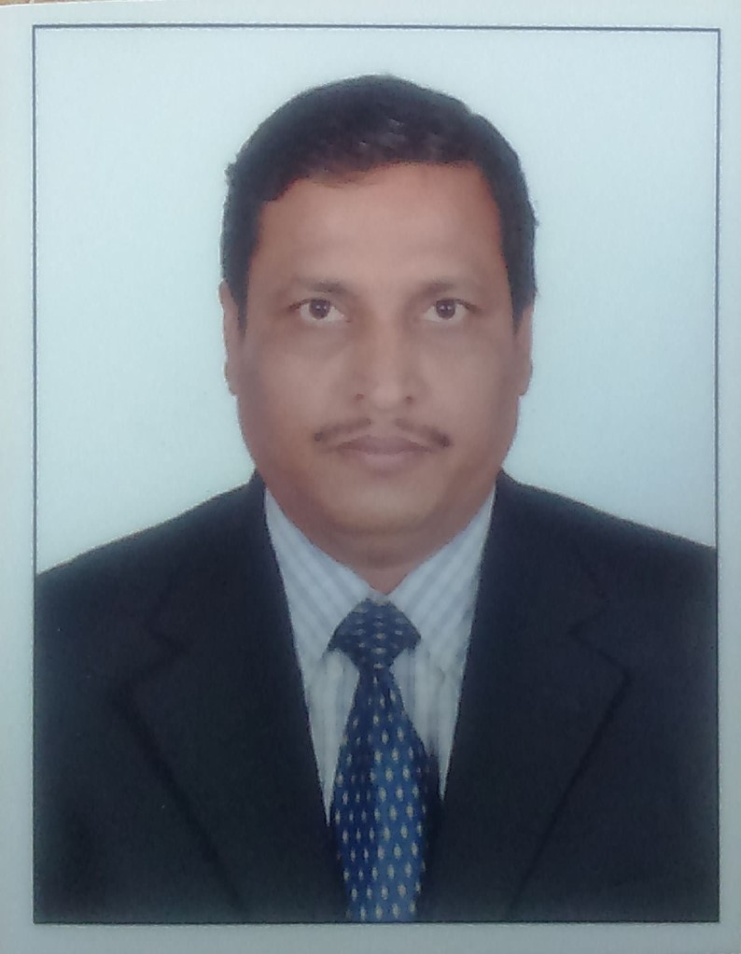
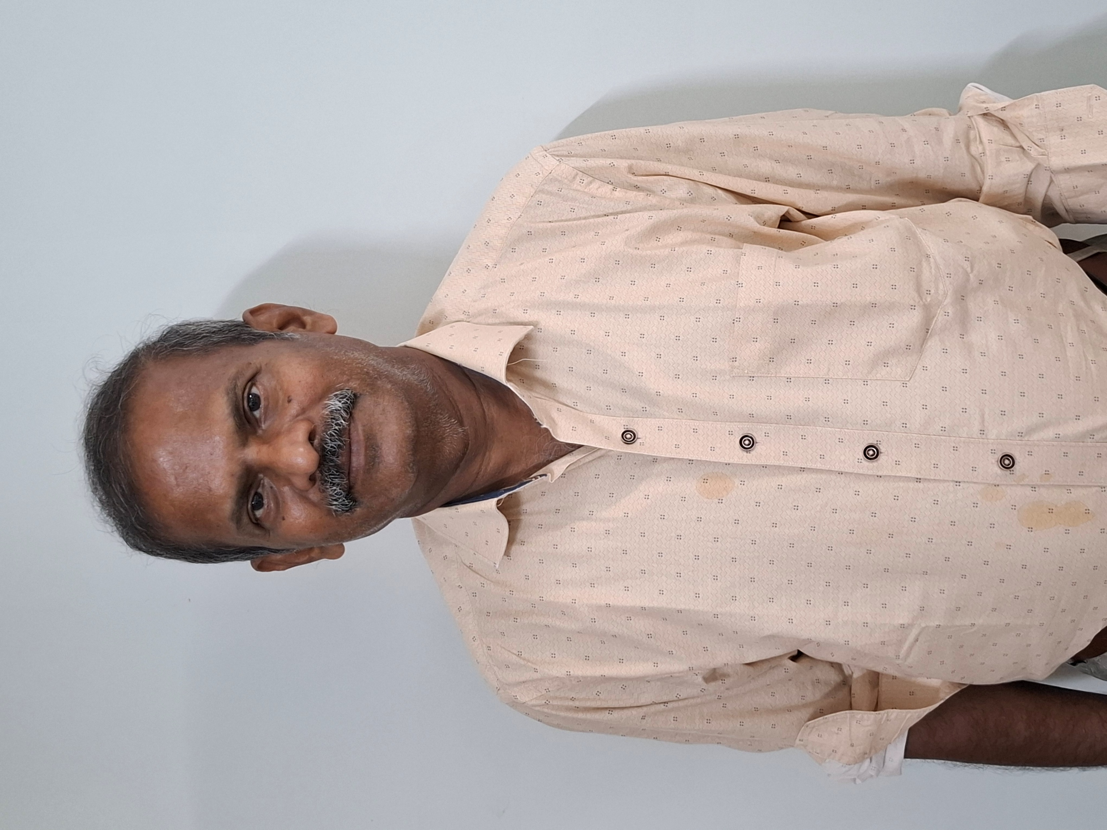
FOUNDING team - Experienced professionals with expertise in engineering, renewable energy, and project management
Thiyagarajan S
Dr. Raja Munusamy
Background and Experience
Professional experience of 33 years in Renewable Energy, Project construction such as Green Hydrogen, Green Ammonia, Wind & Solar power plants. With expertise in Electrical Engineering and sub-station contracts, project development in land acquision, power evacuation and electrical connectivity in India and Middle-east Asia.
Commissioned RE – 2500MW, 100 Substations and up to 400KV
Professional experience of 36 years in Hydrogen and Fuel cell Technology and 20 years of Automotive Power train Technologies. With expertise in Fuel Cell System, Li-ion Battery, System and control Engineering delivered BEV and FCEV power trains for various vehicles. Designed and developed Fuel cell and Battery Electric Cars, Buses. Worked on projects with OEM for facilitation of commercial exploitation of greener Hydrogen and Electricity. Created facility for evaluation of performance fuel cell EV power train
Education
MBA Operations with Electrical Engineering
M.Tech in Materials Engineering and Doctorate in Chemistry
Current role
Chief Operating Officer
Chief Technology Officer

